Slide 1
Summer 2017
Submitting Entity Workgroup
July 20, 2017

Slide 2
Agenda
Welcome and Introductions
Arkansas APCD Reports
Year in Review
New DSG Proposed Changes
Other/Discussion

Slide 3
Arkansas APCD Reports

Slide 4
APCD Showcase
Four reports were published on the APCD Council Showcase website:
  Arkansas Medicare HbAq1c Utilization
  Arkansas Medicare Diabetes
  Arkansas Medicare Provider Episode – Bilateral Cataract Removal with Lens Implant
  Arkansas Medicare Chronic Conditions

Slide 5
Arkansas APCD Reports
Reports in Development
  Arkansas EpiPen® Cost Trends
    Price increases across the drug industry have impacted healthcare costs. Arkansas insurers have cited drug prices as a principal factor in higher premium rates for Arkansans. The EpiPen® and EpiPen Jr® Cost Trends in Arkansas illustrates the potential of the APCD’s ability to quickly produce information to inform the policy dialogue to address these concerns

Slide 6
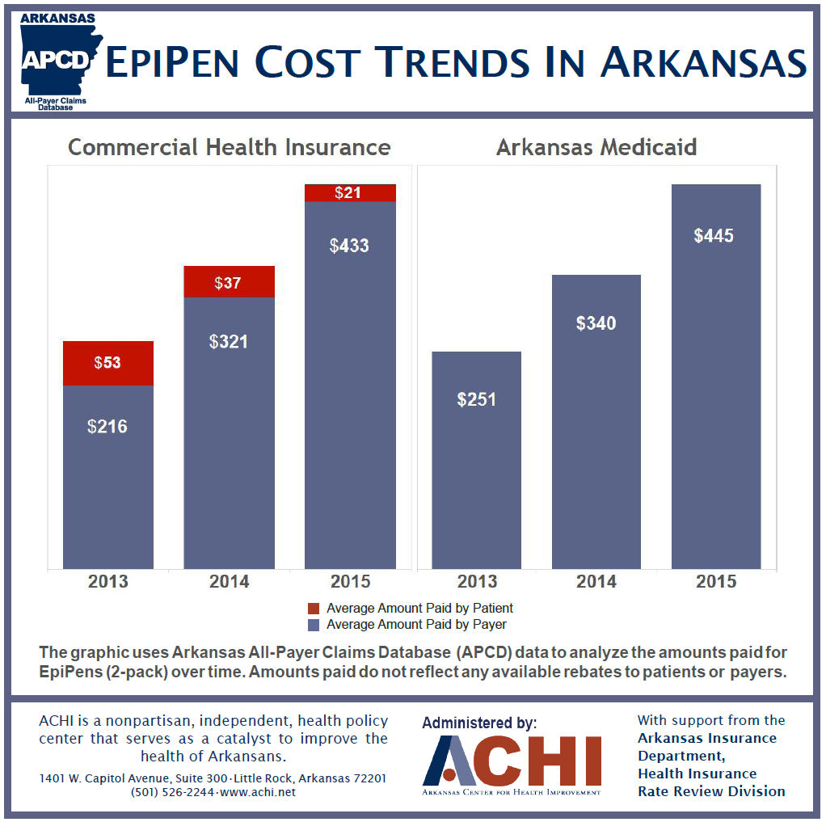
Arkansas APCD Reports

Slide 7
Arkansas APCD Reports
Reports in Development
  Arkansas Insulin Cost Trends (not yet released)
    Like the EpiPen analysis, the Insulin Cost Trends analysis looks at cost changes across years and manufacturers for Medicaid, Medicare, and private carriers.
    This analysis is not complete but has already begun to reveal cost differences between the payers some of which are influenced by gaps created by the Medicare ‘donut hole’ and rebates between Medicaid, private carriers and the drug manufacturers.

Slide 8
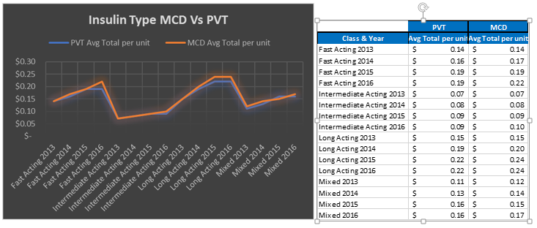
Arkansas APCD Reports

Slide 9
Year in Review

Slide 10
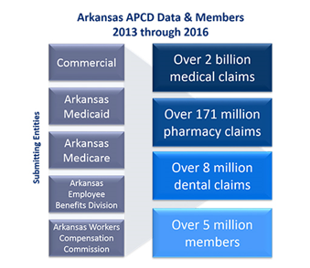
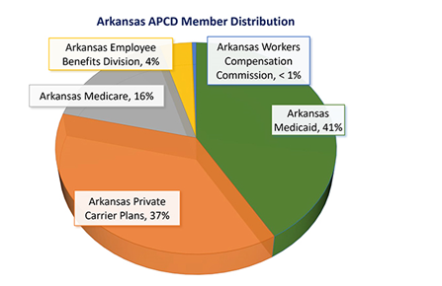
Arkansas APCD Data Statistics
Number of submitting entities - 62
Number of files received – 7649

Slide 11


Arkansas APCD Newsletter
June 2017

Slide 12

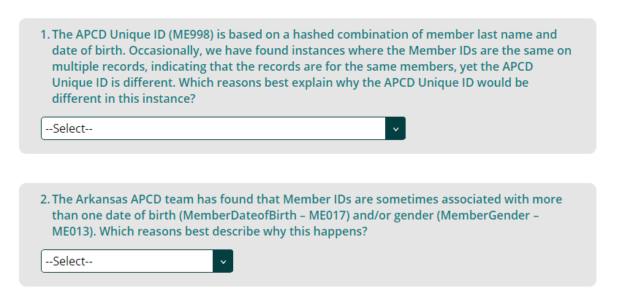
Arkansas APCD Newsletter

Slide 13
Arkansas APCD Newsletter
Data Quality Issues within name and/or date of birth
Name Changes
Other (please specify)

Slide 14
Arkansas APCD Newsletter
Junior/Senior association
Data Quality Issues
Parent/Dependency association
Other (please specify)

Slide 15
Arkansas Legislative Update
SB 565, which adds data elements required for health professional licensure board reporting to us, ADH, and the Minority Health Commission, is now Act 970 of 2017.
Senate Bill 566, to integrate hospital discharge and emergency department visits for the uninsured, cancer registry, and birth and death records into the APCD, is now Act 979 of 2017.
Senate Bill 769, to integrate medical marijuana qualifying patient data into the APCD, is now Act 948 of 2017.

Slide 16
Solution Enhancements
Arkansas Vital Statistics Linkage
  APCD Unique ID will be applied to
    Arkansas Birth Certificate data
    Arkansas Death Certificate data
    Arkansas Hospital Discharge data
    Arkansas Emergency Department data
    Arkansas Cancer Registry Data
On-line Exception Submission Process
JIRA Service Desk support

Slide 17
JIRA Service Desk Support
Used for assisting submitting entities with data submission, technical support, sending new encryption keys, etc.
The ONLY channel of support communication between ARAPCD and Submitting Entities.
If Submitting Entities have never used JIRA Service Desk to reach out to ARAPCD for support, be sure to send a test request to ensure you can receive notifications from JIRA.
Submitting Entities can reach out to ARAPCD Support team via:
  Email support@achiapcd.atlassian.net
  Submit/Update support request via the Help Center https://achiapcd.atlassian.net/servicedesk/customer/portals

Slide 18
Proposed Arkansas Data Submission (DSG) Guide Changes

Slide 19
Revision Highlights
 | Highlights
1 | No DSG version older than 6.0.2018 will be accepted as of March 31, 2018
2 | New requirement – if no data is available for a coverage period, an empty file should be submitted with the missing coverage dates. This helps with logging and data validation continuity.
3 | Coverage period begin and end dates in the header and trailer records must represent the beginning and end of the coverage month.
4 | Default dates should not be used if an actual date is not available. Nulls are required. Note: 9999-12-31 is valid.
5 | The format for ME120 – Actuarial value – has been changed from dollar to percentage. All carriers will be asked to review their exception status for this field and populate it if possible with the new format.
6 | Changed county code to require FIPS codes not county name.

Slide 20
Revision Highlights
 | Highlights
7 | Corrected format to accommodate decimals and negatives.
8 | Decimal points must always be present, even for whole numbers in decimal fields.
9 | Submission files should contain data for one submitting entity only, not multiple.
10 | Added validation process information that a file could be rejected if member IDs did not match across files or previous data submissions. This occurs after data validation reports are delivered.
11 | Addition of new fields to be populated if new claims and/or processing systems are put in place.
12 | Added new Claim Status to represent final claims, or those that will not be adjusted or versioned.

Slide 21
New Fields
Carrier Specific Unique Member ID – Alias (ME107A, MC137A, PC107A, DC056A)
  This field is used when submitting entity internal systems change, resulting in system or sub-system wide member ID changes. This field should contain the original member ID when this change happens. ME107, MC137, PC107, DC056 would contain the new member ID generated by the new system or sub-system.

Slide 22
New Fields
Carrier Specific Unique Subscriber ID – Alias (ME117A, MC141A, PC108A, DC057A)
  This field is used when submitting entity internal systems change, resulting in system or sub-system wide subscriber ID changes. This field should contain the original subscriber ID when this change happens. ME117, MC141, PC108, DC057 would contain the new subscriber ID generated by the new system or sub-system.

Slide 23
New Fields
System ID (ME993, MC993, PC993, DC993, PV993)
  This field represents the submitting entity internal system from which data is sourced.
  The default value is 0, representing the initial system from which the data is pulled. Place the value 0 on all records initially.
  If a system changes, increment the value by 1. For example, if a system changes, the value would change from 0 to 1. If it changes again, the value would change from 1 to 2.
  This ID represents the system at the record level. Some submitting entities combine data from multiple systems into a single submission. If one of these systems changes, the system ID would be incremented on the records from the changed system. The system ID on the remaining records would not change.
  If the system changes resulting in member ID and subscriber ID changes, utilize the Alias fields to capture new and previous member and subscriber IDs for continuity.

Slide 24
Control Count Requirement Changes
Control count values will tie directly back to the data files submitted, enabling record quantity checking for submission validation.
Count attributes will be used to identify types of counts.
The Control Count files will now contain multiple rows, one for each attribute, instead of a single row.
See Control Count examples.

Slide 25
Pre-publication DSG Review Schedule
Arkansas Insurance Department Review
30 days
July/August 2017
Submitting Entity Review
30 days
August/September 2017
Arkansas Healthcare Initiative Board Review
October 2017
Arkansas Insurance Department Commissioner Signature
November 2017
Release to Submitting Entities
December 1, 2017

Slide 26
Other/Discussion

